Slide 1
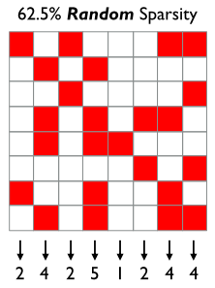
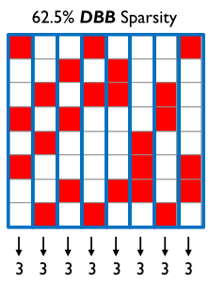
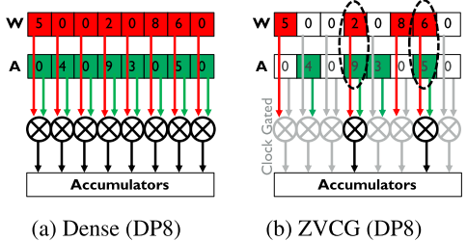
HPCA 2022: S2TA: Exploiting Structured Sparsity for Energy-Efﬁcient Mobile CNN Acceleration
^{[A.8]}
I. Background
II. Challenges and Solutions
1. Convert to Density Bound Block (DBB) sparsity
2. BUT, DISADVANTAGES of state-of-the-art DBB sparsity
Mobile CNN Acceleration
Baseline
W: weights
A: activations
number of non-zero (NNZ)
ZVCG (baseline): 1) detects zero operands (weights and activations) and clock-gates the operand and/or result registers to reduce power dissipation; 2) does not increase throughput, nor reduce the SRAM bandwidth (as the zeros are still stored and read in sequence); 3) reduces the hardware utilization and does not improve area efﬁciency (TOPS/mm2), which is critical for mobile.
Random sparsity patterns leads to variable, unbalanced processing element (PE) utilization at run time, which introduces high energy and area overheads.
DBB divides an activation/weight tensor into blocks and sets the upper bound sparsity of elements in each block.
DBB sparsity constrains the maximum NNZs in a block such that the maximum workload is known at design time.
Benefits: 1) reduce load imbalance and remove the distributed accumulator problem encountered with unstructured sparsity. 2) a simple hardware design
“… we describe S2TA, a systolic array-based CNN accelerator that exploits joint weight and activation DBB sparsity and new dimensions of data reuse unavailable on the traditional systolic array. “
A100 GPU (W-DBB sparsity) from Nvidia | Proposed method
support only ﬁxed 2/4 weight sparsity with up to 2× speedup | 1) exploit both weight and variable activation DBB sparsity for up to 8× speedup; 2) suited to low-power mobile/embedded systems.
[A.8] https://arxiv.org/abs/2107.07983

Slide 2
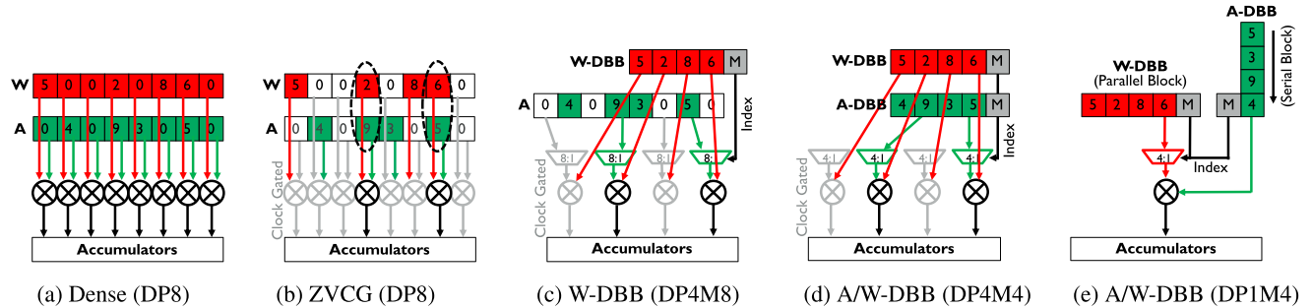
HPCA 2022: S2TA: Exploiting Structured Sparsity for Energy-Efﬁcient Mobile CNN Acceleration
^{[A.8]}
III. Solutions
reduce operand
Bandwidth, power, etc.
IV. Results
an average 2.08× energy reduction and 2.11× speedup
W: Weights
A: Activations
W-DBB alone reduces energy by 1.13×
25% less energy
Baseline
DBB: Weight
static, sparsity known
BUT, Activations:(1) activation sparsity is dynamic and unbounded, (2) optimal activation DBB sparsity varies signiﬁcantly across the layers of a network.
[A.8] https://arxiv.org/abs/2107.07983
For Activations:
1. Dynamic Activation Pruning (DAP): prunes and compresses the dense activation tensors into the DBB format; a lossy scheme, can degrade test accuracy, but without signiﬁcant accuracy loss.
2. Switch from unrolling the elements in the A-DBB blocks spatially (d) to serializing them in time (e):
Process one element of the activation block per cycle using a single MAC, over multiple cycles.
For example, a layer with low density activations can use 1/8 DBB, requiring just one cycle per block; while, a layer with denser 5/8 DBB activations requires ﬁve cycles.
Vary the activation block density per layer directly by changing the number of cycles per block.
Datapath utilization and operand bandwidth remain constant.

Slide 3
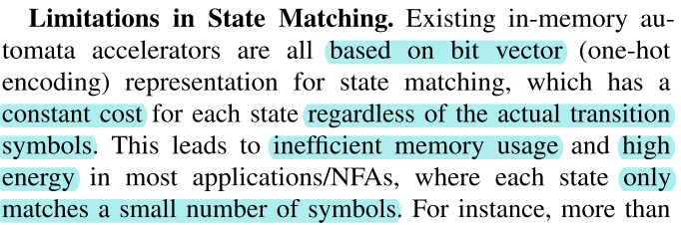
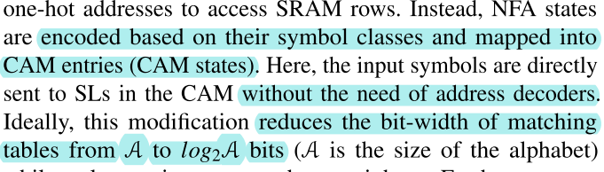
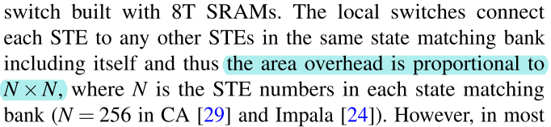
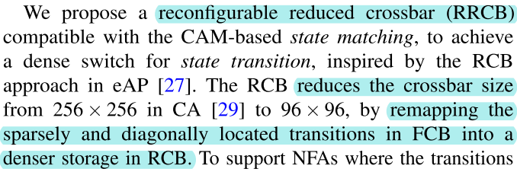

HPCA 2022: Energy and Memory Efﬁcient Automata Processing in Content-Addressable Memories
^{[A.11]}
I. Background
IV. Experiment and Results
Content Addressable Memory (CAM): suitable for ﬁxed-width bit string matching and extensively used in networking for IP lookup and packet classiﬁcation.
Compared to Deterministic Finite Automaton (DFA), the Non-deterministic FA (NFA) holds multiple active states at the same time and supports multiple transitions on a single input.
However, existing CAM-based methods cannot handle complex applications beyond packet inspection, because of the state explosion issues in converting an expressive NFA to a DFA .
Two versions of CAMA designs, one optimized for energy (CAMA-E) and the other for throughput (CAMA-T),
Use 21 common real-world and synthetic benchmarks.
Compared to state-of-the-art (SOTA) designs, CAMA-E achieves > 2×lower energy, while CAMA-T shows > 2.6× higher compute density.
“We propose CAMA, the ﬁrst CAM-enabled, low-area, and energy-efﬁcient Automata processor for homogenous NFA in streaming processing, which replaces the bit vector representation in SOTA RAM-based designs by direct symbol matching in CAMs. “
II. Challenges
III. Solutions*
state matching
* All existing in-memory automata processors execute an automaton in two steps: state matching and state transition.
* SL: search line
state transition
[A.11] https://arxiv.org/abs/2112.00267
* In addition to the major methods introduced here, the paper also introduced an optimization framework.

Slide 4
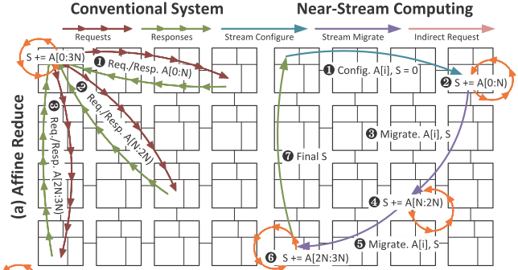
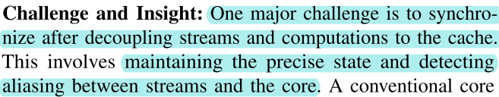
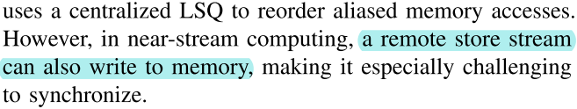
HPCA 2022: Near-Stream Computing: General and Transparent Near-Cache Acceleration
^{[A.12]}
II. Near-Stream
I. Background
Streams
Definition: streams are coarse grain memory access patterns, powerful instruction set architecture (ISA) abstraction for near data ofﬂoading.
Benefits: “Tracking data access at stream-granularity heavily reduces the burden of coordination for providing sequential semantics. Decomposing the problem using streams means that arbitrary combinations of address and computation patterns can be combined for broad generality.”
Overheads of data movement and communication become primary bottlenecks in HPC.
Near data computing is one of the solutions. It mitigate overheads by scheduling computation near data and orchestrating data-movement in efﬁcient pipelines.
Near-Data Processing (NDP)
Near Memory
Near Cache
Near Stream (this paper)
Example: case of afﬁne reduction
Fetch all the data to the core to accumulate the result (multiple request/response arrows); introduce unnecessary trafﬁc.
With streams, remote logic link control (LLC) perform computation in place; automatically migrates to the next LLC bank with new data and keeps reducing during stream iterates; nearly all data trafﬁc is eliminated.”
“…our goal is to provide effective and general near-cache computing capability for general purpose cores without programmer help.”
Challenges:
[A.12] https://seanzw.github.io/pub/hpca2022-near-stream-computing.pdf

Slide 5
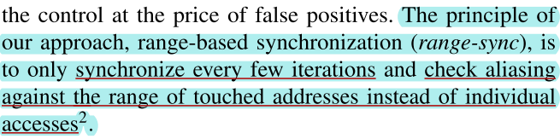
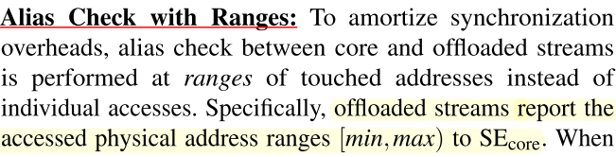
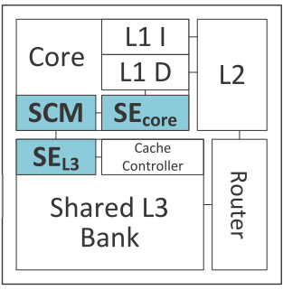
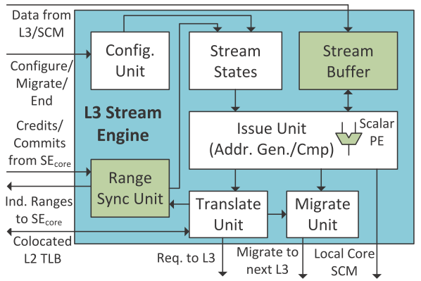
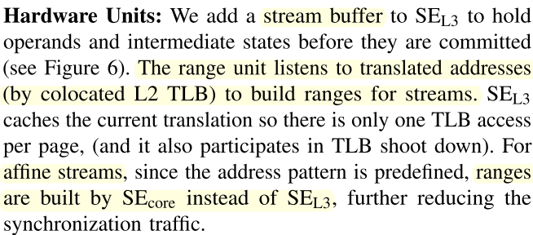

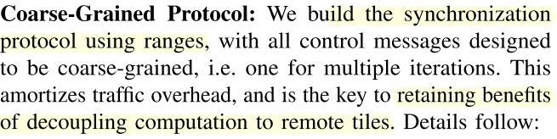

HPCA 2022: Near-Stream Computing: General and Transparent Near-Cache Acceleration
^{[A.12]}
III. Solutions
Range-Based Synchronization
Streams access a single data structure, so their addresses tend to be conﬁned in a limited (physical address) range.
SCM: stream computing manager.
SE_{core}: core stream engines
SE_{L3}: analogous stream engine to shared Level 3 (L3) banks
L3 Stream Engine (SE_{L3})
: indicates processing steps, their order is approximated for the purpose of explanation
: the major processing component, it can be more than one
[A.12] https://seanzw.github.io/pub/hpca2022-near-stream-computing.pdf

Slide 6

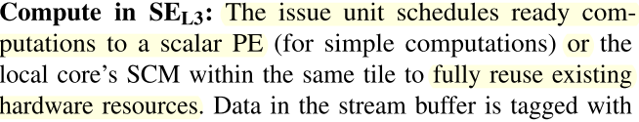
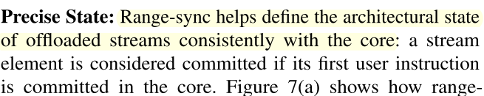

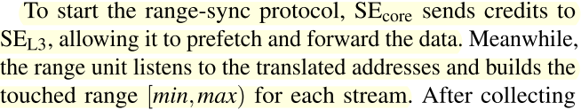

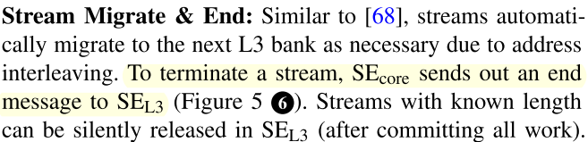

HPCA 2022: Near-Stream Computing: General and Transparent Near-Cache Acceleration
^{[A.12]}
III. Solutions
Range-Based Synchronization
From last page
L3 Stream Engine (SE_{L3})
SCM: stream computing manager.
SE_{core}: core stream engines
SE_{L3}: analogous stream engine to shared Level 3 (L3) banks
: indicates processing steps, their order is approximated for the purpose of explanation
: the major processing component, it can be more than one
IV. Experiment and Results
[A.12] https://seanzw.github.io/pub/hpca2022-near-stream-computing.pdf

Slide 7
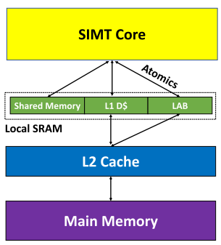
HPCA 2022: Only Buffer When You Need To: Reducing On-chip GPU Trafﬁc with Reconﬁgurable Local Atomic Buffers ^{[A.13]}
^{[A.13]}
I. Background and Challenges
III. Solutions
ML training algorithms use atomics to update shared weights.
Atomics:
Atomic operations, or simply Atomics, are CPU/GPU operations which are used to update shared global variables in GPUs and are performed without interference from any other threads. Atomic operations are often used to prevent race conditions which are common problems in mulithreaded applications [A.13.1].
Locally scoped atomics: only guaranteed to be visible to other threads in the same thread block (TB).
Device-scoped atomics: visible to all threads across the GPU.
Relaxed atomics: imply no ordering on other memory accesses, they can be reordered with other data and atomic accesses. They are commutative.
GPUs do not efﬁciently support atomics, which limit scalability.
Atomics in ML training commutatively updating shared variables, so they do not need ordering and can use lower overhead relaxed atomics.
Key insights: the order of the atomics in ML training does not matter since the program does not view the updated values until all updates have completed and the updated weights are not used until subsequent layers, so atomics are commutative and can be relaxed.
“… propose a hardware-software co-design approach that reduces atomic latency,
data movement, and energy“
Software: identify relaxed atomics.
Hardware: add local atomic buffer (LAB) to handle device-scoped (global) atomics.
[A.13] https://wu-kan.cn/2022/03/16/Only-Buffer-When-You-Need-To-Reducing-On-chip-GPU-Traffic-with-Reconfigurable-Local-Atomic-Buffers/
[A.13.1] supercomputingblog.com/cuda/cuda-tutorial-4-atomic-operations/

Slide 8
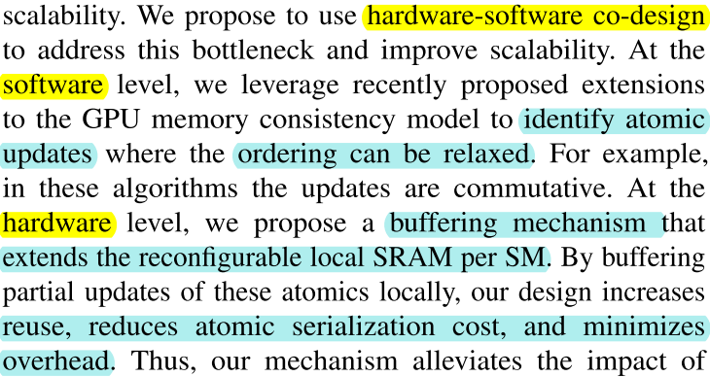
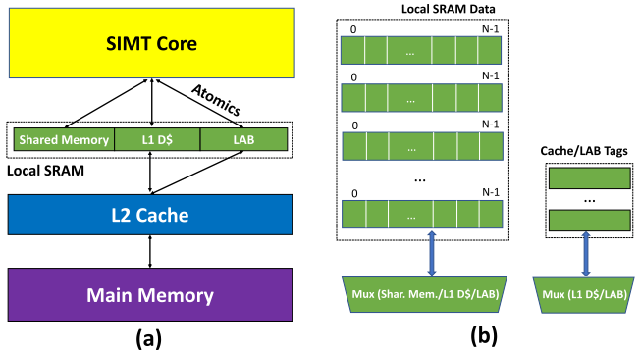
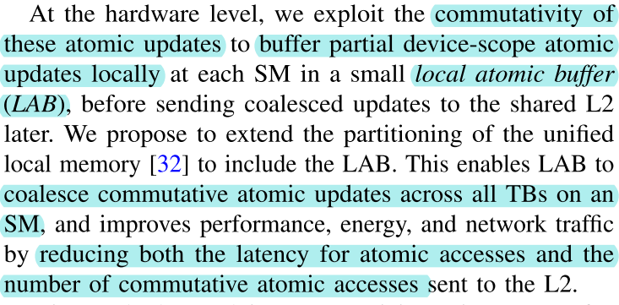
HPCA 2022: Only Buffer When You Need To: Reducing On-chip GPU Trafﬁc with Reconﬁgurable Local Atomic Buffers ^{[A.13]}
^{[A.13]}
Hardware Support
s
III. Solutions
Add a buffer to combine atomics that are commutative.
SM: streaming multiprocessor.
Figure: Proposed design (a) including LAB (in green) and (b) local SRAM. Source: [A.13]
Software: Distinguishing Atomic Operations
LAB relies on identifying which atomic accesses can be buffered locally (e.g., commutative atomics). So, the introduced a new memory ordering ( memory_order_comm) to identify commutative accesses.
s
IV. Experiment and Results
improved performance by 28%, energy by 19%, and network trafﬁc by 19% on average.

